Slide 1
Operations Management
William J. Stevenson
8th edition

Slide 2
CHAPTER
9
Management
of Quality
Operations Management, Eighth Edition, by William J. Stevenson
Copyright © 2005 by The McGraw-Hill Companies, Inc. All rights reserved.
McGraw-Hill/Irwin

Slide 3
Quality Management
What does the term quality mean?
Quality is the ability of a product or service to consistently meet or exceed customer expectations.

Slide 4
Evolution of Quality Management
1924 - Statistical process control charts
1930 - Tables for acceptance sampling
1940’s - Statistical sampling techniques
1950’s - Quality assurance/TQC
1960’s - Zero defects
1970’s - Quality assurance in services

Slide 5
Quality Assurance vs. Strategic Approach
Quality Assurance
  Emphasis on finding and correcting defects before reaching market
Strategic Approach
  Proactive, focusing on preventing mistakes from occurring
  Greater emphasis on customer satisfaction

Slide 6
The Quality Gurus
Walter Shewhart
  “Father of statistical quality control”
W. Edwards Deming
Joseph M. Juran
Armand Feignbaum
Philip B. Crosby
Kaoru Ishikawa
Genichi Taguchi

Slide 7
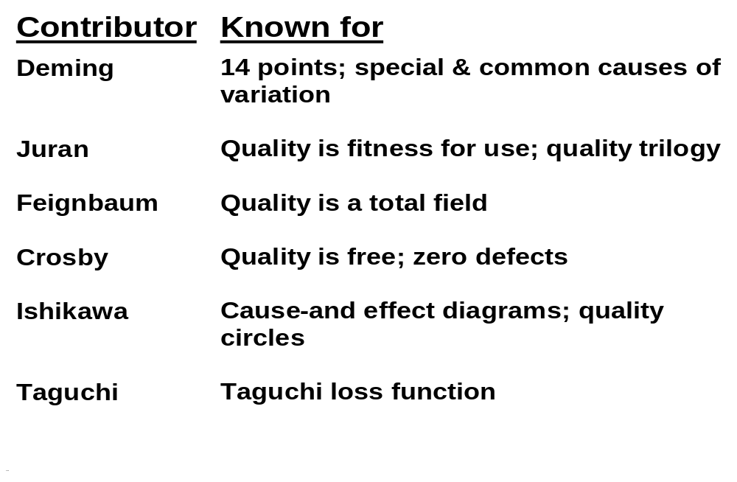
Key Contributors to Quality Management
Table 9.2

Slide 8
Dimensions of Quality
Performance - main characteristics of the product/service
Aesthetics - appearance, feel, smell, taste
Special Features - extra characteristics
Conformance - how well product/service conforms to customer’s expectations
Reliability - consistency of performance

Slide 9
Dimensions of Quality (Cont’d)
Durability - useful life of the product/service
Perceived Quality - indirect evaluation of quality (e.g. reputation)
Serviceability - service after sale

Slide 10
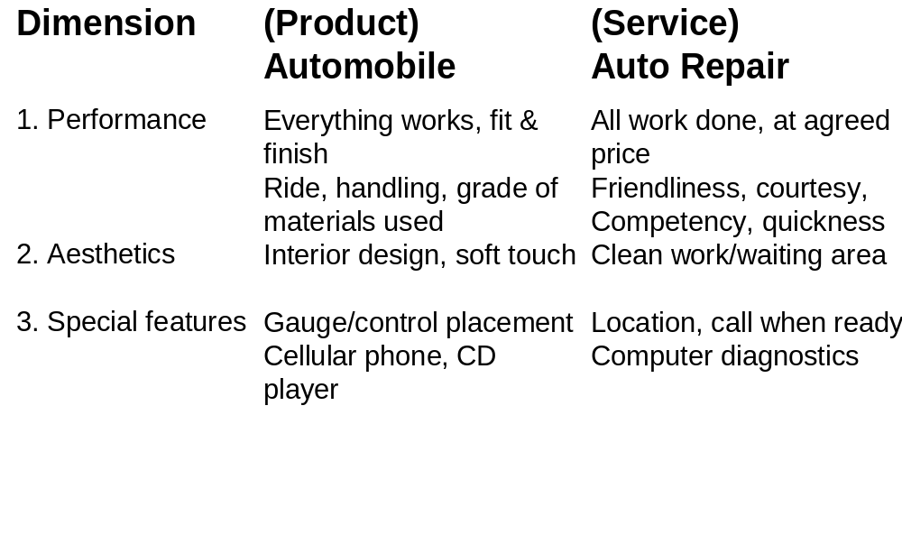
Examples of Quality Dimensions

Slide 11
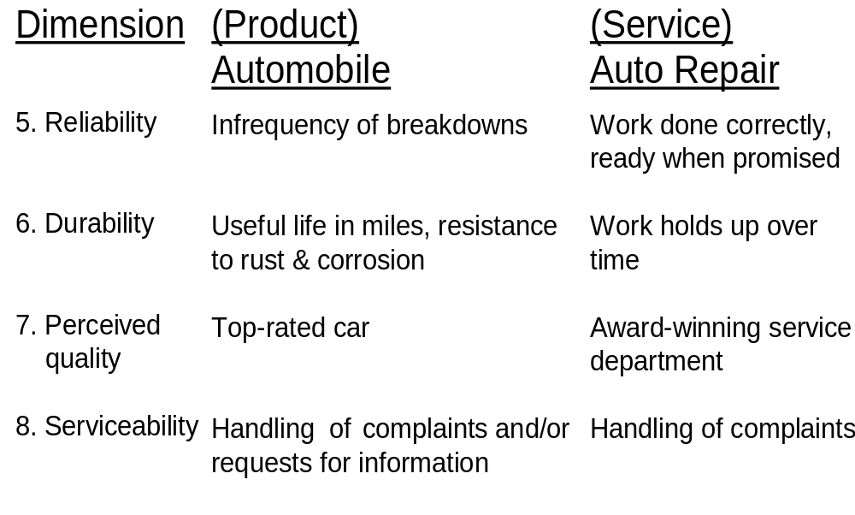
Examples of Quality Dimensions (Cont’d)

Slide 12
Service Quality
Tangibles
Convenience
Reliability
Responsiveness
Time
Assurance
Courtesy

Slide 13
Examples of Service Quality
Table 9.4
Dimension | Examples
1. Tangibles | Were the facilities clean, personnel neat?
2. Convenience | Was the service center conveniently located?
3. Reliability | Was the problem fixed?
4. Responsiveness | Were customer service personnel willing and able to answer questions?
5. Time | How long did the customer wait?
6. Assurance | Did the customer service personnel seem knowledgeable about the repair?
7. Courtesy | Were customer service personnel and the cashierfriendly and courteous?

Slide 14
Determinants of Quality
Ease of
use
Design
Conforms
to design
Service

Slide 15
Determinants of Quality (cont’d)
Quality of design
  Intension of designers to include or exclude features in a product or service
Quality of conformance
  The degree to which goods or services conform to the intent of the designers

Slide 16

The Consequences of Poor Quality
Loss of business
Liability
Productivity
Costs

Slide 17
Responsibility for Quality
Top management
Design
Procurement
Production/operations
Quality assurance
Packaging and shipping
Marketing and sales
Customer service

Slide 18
Costs of Quality (continued)
Appraisal Costs
  Costs of activities designed to ensure quality or uncover defects
Prevention Costs
  All TQ training, TQ planning, customer assessment, process control, and quality improvement costs to prevent defects from occurring

Slide 19
Costs of Quality
Failure Costs - costs incurred by defective parts/products or faulty services.
Internal Failure Costs
  Costs incurred to fix problems that are detected before the product/service is delivered to the customer.
External Failure Costs
  All costs incurred to fix problems that are detected after the product/service is delivered to the customer.

Slide 20
Ethics and Quality
Substandard work
  Defective products
  Substandard service
  Poor designs
  Shoddy workmanship
  Substandard parts and materials
Having knowledge of this and failing to correct
and report it in a timely manner is unethical.

Slide 21

Quality Awards
Baldrige Award
Deming Prize

Slide 22
Malcolm Baldrige National Quality Award
1.0 Leadership (125 points)
2.0 Strategic Planning (85 points)
3.0 Customer and Market Focus (85 points)
4.0 Information and Analysis (85 points)
5.0 Human Resource Focus (85 points)
6.0 Process Management (85 points)
7.0 Business Results (450 points)

Slide 23
Benefits of Baldrige Competition
Financial success
Winners share their knowledge
The process motivates employees
The process provides a well-designed quality system
The process requires obtaining data
The process provides feedback

Slide 24
European Quality Award
Prizes intended to identify role models
  Leadership
  Customer focus
  Corporate social responsibility
  People development and involvement
  Results orientation

Slide 25
The Deming Prize
Honoring W. Edwards Deming
Japan’s highly coveted award
Main focus on statistical quality control

Slide 26
Quality Certification
ISO 9000
  Set of international standards on quality management and quality assurance, critical to international business
ISO 14000
  A set of international standards for assessing a company’s environmental performance

Slide 27
ISO 9000 Standards
Requirements
System requirements
Management requirements
Resource requirements
Realization of requirements
Remedial requirements

Slide 28
ISO 9000 Quality Management Principles
A systems approach to management
Continual improvement
Factual approach to decision making
Mutually beneficial supplier relationships
Customer focus
Leadership
People involvement
Process approach

Slide 29
ISO 14000
ISO 14000 - A set of international standards for assessing a company’s environmental performance
Standards in three major areas
  Management systems
  Operations
  Environmental systems

Slide 30
ISO 14000
Management systems
  Systems development and integration of environmental responsibilities into business planning
Operations
  Consumption of natural resources and energy
Environmental systems
  Measuring, assessing and managing emissions, effluents, and other waste

Slide 31

Total Quality Management
A philosophy that involves everyone in an organization in a continual effort to improve quality and achieve customer satisfaction.
T
Q
M

Slide 32
The TQM Approach
Find out what the customer wants
Design a product or service that meets or exceeds customer wants
Design processes that facilitates doing the job right the first time
Keep track of results
Extend these concepts to suppliers

Slide 33
Elements of TQM
Continual improvement
Competitive benchmarking
Employee empowerment
Team approach
Decisions based on facts
Knowledge of tools
Supplier quality
Champion
Quality at the source
Suppliers

Slide 34

Continuous Improvement
Philosophy that seeks to make never-ending improvements to the process of converting inputs into outputs.
Kaizen: Japanese
word for continuous
improvement.

Slide 35
Quality at the Source
The philosophy of making each worker responsible for the quality of his or her work.

Slide 36
Six Sigma
Statistically
  Having no more than 3.4 defects per million
Conceptually
  Program designed to reduce defects
  Requires the use of certain tools and techniques

Slide 37
Six Sigma Programs
Six Sigma programs
  Improve quality
  Save time
  Cut costs
Employed in
  Design
  Production
  Service
  Inventory management
  Delivery

Slide 38
Six Sigma Management
Providing strong leadership
Defining performance metrics
Selecting projects likely to succeed
Selecting and training appropriate people

Slide 39
Six Sigma Technical
Improving process performance
Reducing variation
Utilizing statistical models
Designing a structured improvement strategy

Slide 40
Six Sigma Team
Top management
Program champions
Master “black belts”
“Black belts”
“Green belts”

Slide 41
Six Sigma Process
Define
Measure
Analyze
Improve
Control
DMAIC

Slide 42
Obstacles to Implementing TQM
Lack of:
  Company-wide definition of quality
  Strategic plan for change
  Customer focus
  Real employee empowerment
  Strong strong motivation
  Time to devote to quality initiatives
  Leadership

Slide 43
Obstacles to Implementing TQM
Poor inter-organizational communication
View of quality as a “quick fix”
Emphasis on short-term financial results
Internal political and “turf” wars

Slide 44
Criticisms of TQM
Blind pursuit of TQM programs
Programs may not be linked to strategies
Quality-related decisions may not be tied to market performance
Failure to carefully plan a program

Slide 45
Basic Steps in Problem Solving
Define the problem and establish an improvement goal
Collect data
Analyze the problem
Generate potential solutions
Choose a solution
Implement the solution
Monitor the solution to see if it accomplishes the goal

Slide 46
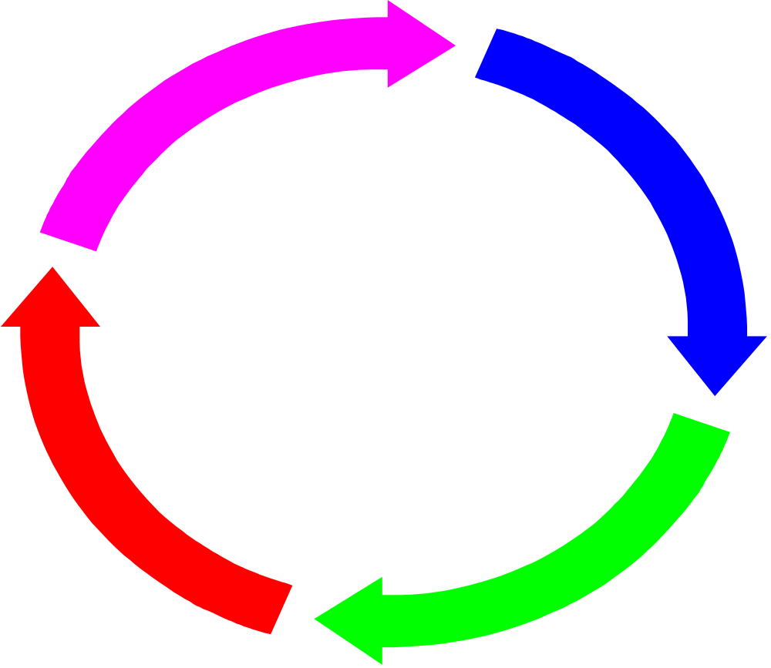
The PDSA Cycle
Plan
Act
Do
Study

Slide 47
Process Improvement
Process Improvement: A systematic approach to improving a process
Process mapping
Analyze the process
Redesign the process

Slide 48







The Process Improvement Cycle
Select a
process
Document
Study/document
Evaluate
Seek ways to
Improve it
Implement the
Improved process
Design an
Improved process

Slide 49
Process Improvement and Tools
Process improvement - a systematic approach to improving a process
  Process mapping
  Analyze the process
  Redesign the process
Tools
  There are a number of tools that can be used for problem solving and process improvement
  Tools aid in data collection and interpretation, and provide the basis for decision making

Slide 50
Basic Quality Tools
Flowcharts
Check sheets
Histograms
Pareto Charts
Scatter diagrams
Control charts
Cause-and-effect diagrams
Run charts

Slide 51
Check Sheet
Monday
Billing Errors
  Wrong Account
  Wrong Amount
A/R Errors
  Wrong Account
  Wrong Amount

Slide 52
Pareto Analysis
80% of the problems may be attributed to 20% of the
causes.
Number of defects
Off
center
Smeared
print
Missing
label
Loose
Other

Slide 53
Control Chart
Figure 9.11
1020
UCL
1010
1000
990
LCL
980
970
0
1
2
3
4
5
6
7
8
9
10
11
12
13
14
15

Slide 54
Cause-and-Effect Diagram
Figure 9.12
Methods
Materials
Cause
Cause
Cause
Cause
Effect
Cause
Cause
Environment
Cause
Cause
Cause
Cause
Cause
Cause
People
Equipment

Slide 55
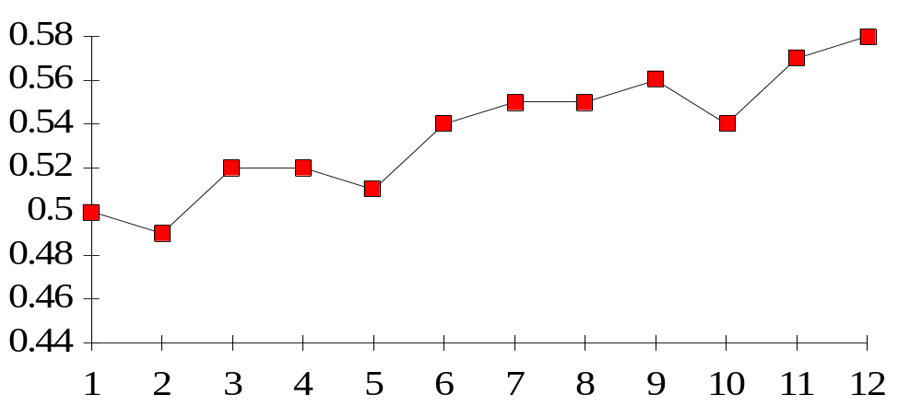
Run Chart
Diameter
Time (Hours)

Slide 56
Tracking Improvements
Figure 9-17
UCL
UCL
UCL
LCL
LCL
Additional improvements
made to the process
LCL
Process centered
and stable
Process not centered
and not stable

Slide 57

Methods for Generating Ideas
Brainstorming
Quality circles
Interviewing
Benchmarking
5W2H

Slide 58
MCQ
Which among the following is not part of cost of quality
a) Production cost
b) Appraisal cost
c) Failure cost
d) prevention cost
Which among the following is not a dimension of product quality
a) convenience
b) durability
c) consistency
d) aesthetics
Which among the following is not an determinants of quality
a) design
b) how well the product/service conforms to design
c) ease of use
d) delivery after service
4. Statistically six sigma means not more than ……………defects per million a) 4.3 b) 3.4 c) six d) 2.4

Slide 59
Quality Circles
Team approach
  List reduction
  Balance sheet
  Paired comparisons

Slide 60
Benchmarking Process
Identify a critical process that needs improving
Identify an organization that excels in this process
Contact that organization
Analyze the data
Improve the critical process

